Slide 1
Final Engagement
Attack, Defense & Analysis of a Vulnerable Network

Slide 2
Table of Contents
This document contains the following resources:
Network Topology & Critical Vulnerabilities
Exploits Used
Avoiding Detect
Network Topology & Critical Vulnerabilities

Slide 3

Network Topology
& Critical Vulnerabilities
3

Slide 4
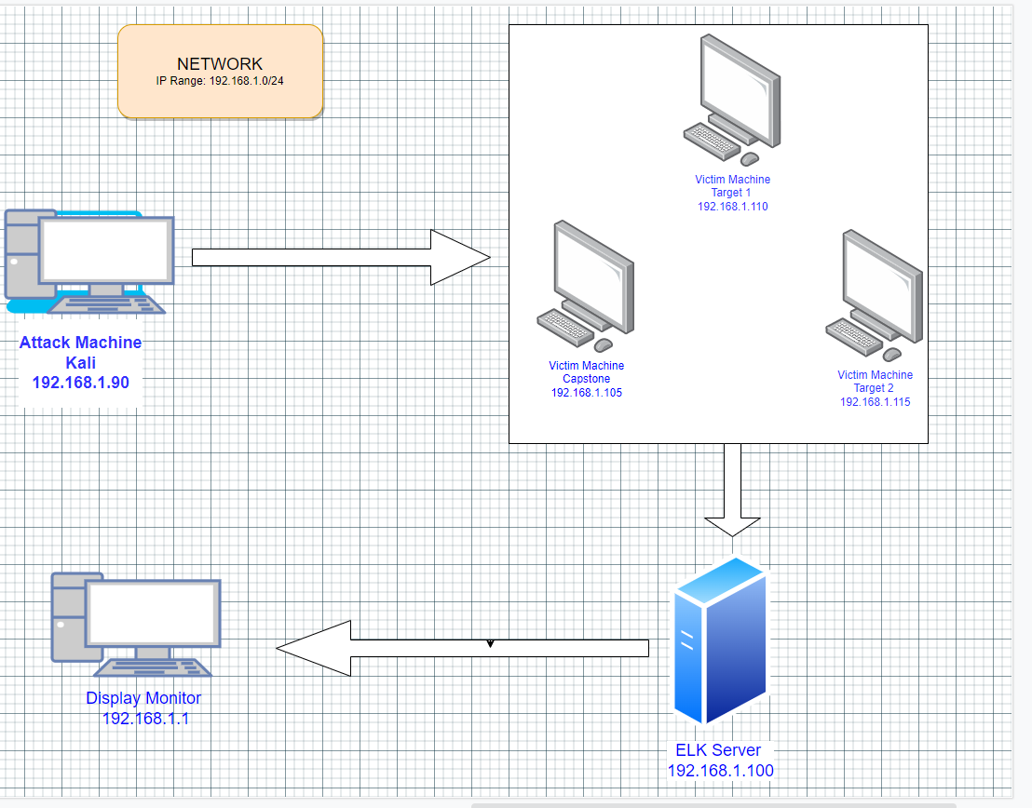
Network Topology
Network
Address Range: 192.168.1.1/24
Netmask: 255.255.255.0
Gateway: 192.168.1.1
Machines
IPv4: 192.168.1.90
OS: Kali Linux
Hostname: Kali
IPv4: 192.168.1.110
OS: Linux
Hostname: Target 1
IPv4: 192.168.1.115
OS: Linux
Hostname: Target 2
IPv4: 192.168.1.100
OS: Linux
Hostname: Elk

Slide 5
Critical Vulnerabilities: Target 1
Our assessment uncovered the following critical vulnerabilities in Target 1.
Vulnerability | Description | Impact
WordPress XML ping back | Can be exploited by a simple Post to a specific file on an offected wordpress server . | Allowed for users to keep the same password for as long as they please making brute force attacks more likely to be successful.
Sensitive Data Exposure | MYSQL login information being accessible through a non-admin, common account. | Gave anyone logged into user “Michael” access to MYSQL
Security Misconfiguration | Going hand & hand with previous vulnerabilities, misconfiguration includes unprotected files/directories, default account credentials, unoptimised systems, etc. | Once again, allowing unprivileged users access to files they shouldn’t be allowed to have, such as the “wp-config.php” file that inherits the MYSQL login information

Slide 6
Exploits Used
6

Slide 7
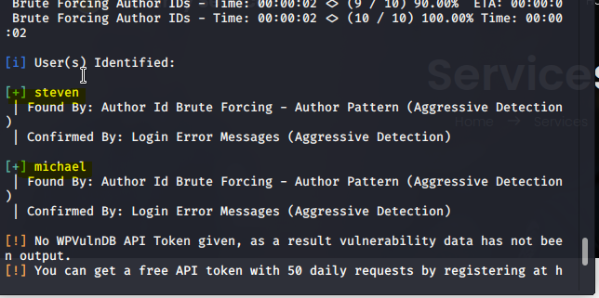
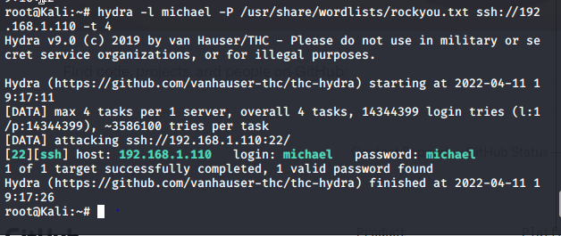
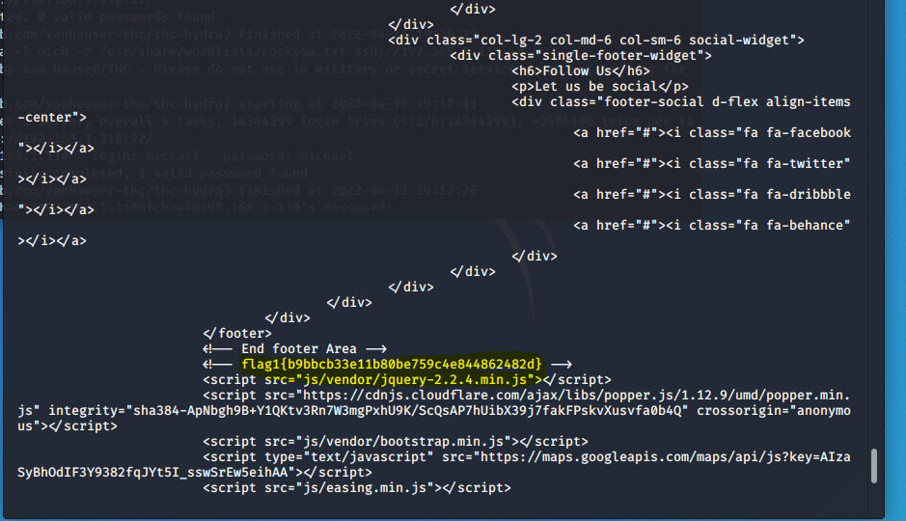
Exploitation: Open port 22 SSH and weak Password
Summarize the following:
Using WPScan we find two users, Michael and Steven. Putting Michael’spassword through Hydra it is revealed that Michael’s password is the same as the login.

Slide 8
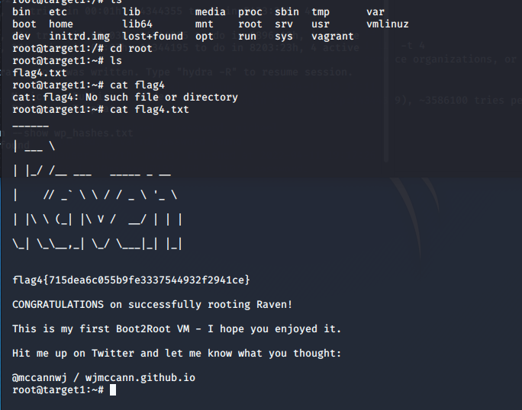
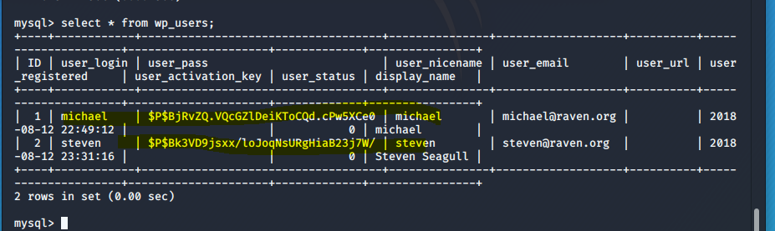
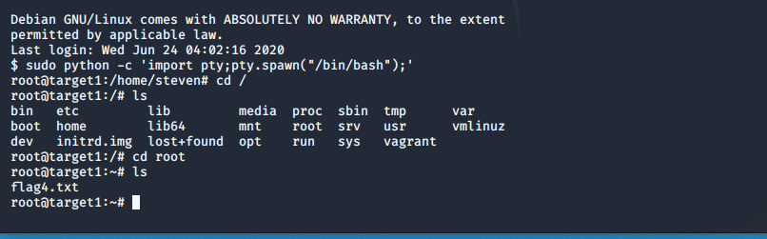
Exploitation: Sensitive Data Exposure
Summarize the following:
Once logged in using the credentials retrieved as the User Michael, we were
able to dump the password hashes from wp_users table
We exploited Steven's python when we cracked the password using John the ripper.

Slide 9
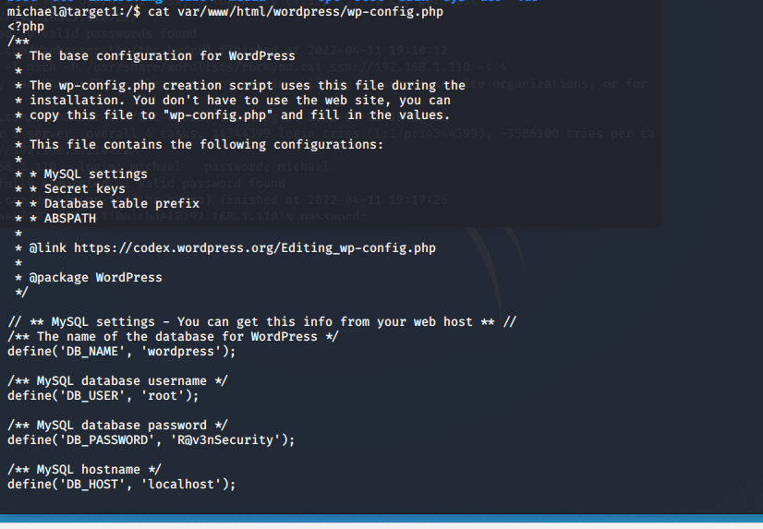
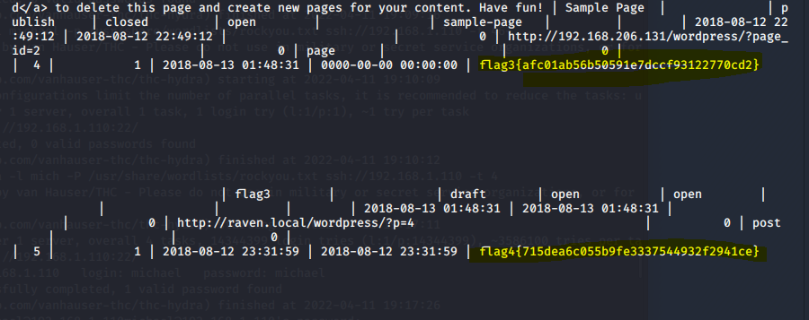
Exploitation: Wordpress configuration and SQL Database
Summarize the following:
The username and password to access the MySQL database,/the
wp-config.php.
The exploit granted us MySQL access and allowed us to find flag3 and falg4
.

Slide 10
Avoiding Detection
10

Slide 11
Stealth Exploitation of Worpress Configuration and SQL Database
Monitoring Overview
SQL Database Alert
Monitor server traffic for unauthorized attempts to access SQL Database
Triggers when external/unauthorized IP connections are made to the SQL Database or any related file
Mitigating Detection
Employ IP address spoofing
Brute-force SQL Database with Password cracking tool, Connect to the same network
If possible, include a screenshot of your stealth technique.

Slide 12
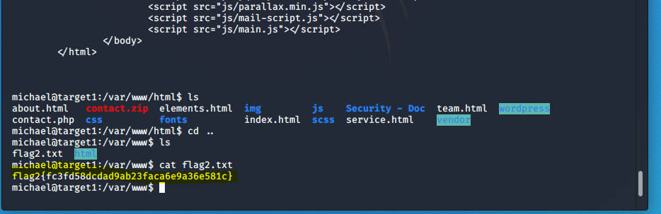
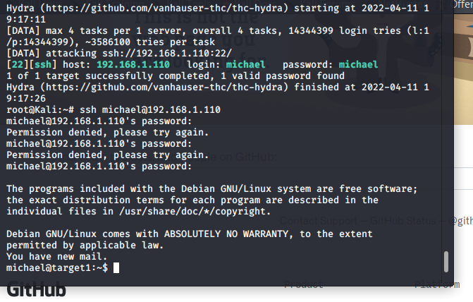
Stealth Exploitation of Open Port 22 SSH and Weak password
Monitoring Overview
SSH Login Alert world detect this exploit
Monitor SSH Port for unauthorized access
Triggers when user attempts to access system
over Port 22
Mitigating Detection
SSH through a different open port that is less obvious
Other exploit ideas reverse shell exploit

Slide 13
Stealth Exploitation of Privilege Escalation
Monitoring Overview
Privilege Escalation Alert
Monitor unauthorized root access attempts as well as super doer activity
Triggers when unauthorized sudo command usage or privileged directory access is attempted by unauthorized users regardless of report flagging
Mitigating Detection
Finding vulnerabilities in the kernel and exploiting them for root access

